Slide 1
An Overview of Machine Learning & Data Mining
Ahmed Kowsher
AI Scientist at Hishab LTD, Bangladesh
Reasearch Scientist at Voicebridge, Germany
Formar AI Engineer, NKSoft, Dalas, USA

Slide 2
Outline & Content
What is machine learning?
Learning system model
Training and testing
Performance
Algorithms
Machine learning structure
Applications
Supportive Documents
Course Structure

Slide 3
What is machine learning?
A branch of artificial intelligence, concerned with the design and development of algorithms that allow computers to evolve behaviors based on empirical data.
As intelligence requires knowledge, it is necessary for the computers to acquire knowledge.

Slide 4
Learning system model
Testing
Input Samples
Learning Method
System
Training

Slide 5
Training and testing
Data acquisition
Practical usage
Universal set
(unobserved)
Training set (observed)
Testing set
(unobserved)

Slide 6
Training and testing
Training is the process of making the system able to learn.
No free lunch rule:
Training set and testing set come from the same distribution
Need to make some assumptions or bias

Slide 7
Performance
There are several factors affecting the performance:
Types of training provided
The form and extent of any initial background knowledge
The type of feedback provided
The learning algorithms used
Two important factors:
Modeling
Optimization

Slide 8
Algorithms
The success of machine learning system also depends on the algorithms.
The algorithms control the search to find and build the knowledge structures.
The learning algorithms should extract useful information from training examples.

Slide 9


Algorithms
Supervised learning ( )
Prediction
Classification (discrete labels), Regression (real values)
Unsupervised learning ( )
Clustering
Probability distribution estimation
Finding association (in features)
Dimension reduction
Semi-supervised learning
Reinforcement learning
Decision making (robot, chess machine)

Slide 10
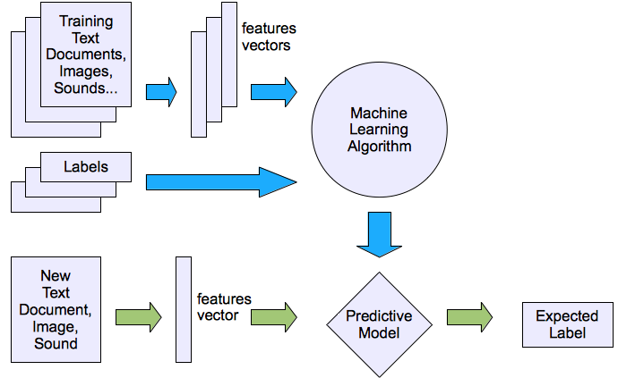
Machine learning structure
Supervised learning

Slide 11
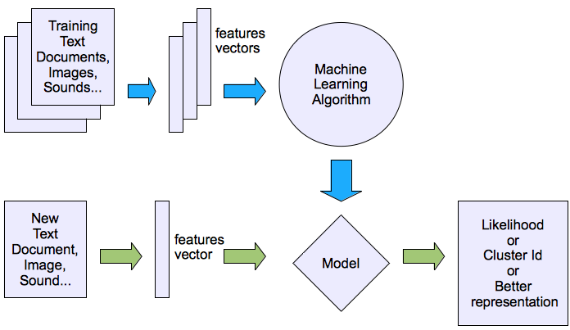
Machine learning structure
Unsupervised learning

Slide 12
Applications
Face detection
Object detection and recognition
Image segmentation
Multimedia event detection
Economical and commercial usage

Slide 13
Supportive Documents
Python:
https://www.w3schools.com/python/
Numpy:
https://www.youtube.com/watch?v=mOZ0UCeuRX4&ab_channel=APMonitor.com
Vector:
https://www.youtube.com/watch?v=ml4NSzCQobk&ab_channel=TED-Ed
Matrices:
https://www.youtube.com/watch?v=bDoqKswdp6c&ab_channel=MyWhyU
Linear Algebra:
https://www.youtube.com/watch?v=celUu5aY6_Q&ab_channel=MATLABProgrammingforNumericalComputation
Calculus:
https://www.youtube.com/watch?v=WsQQvHm4lSw&ab_channel=TheOrganicChemistryTutor
Statistics:
https://www.youtube.com/watch?v=kyjlxsLW1Is&ab_channel=zedstatistics

Slide 14
Course Structure
Learn Algorithm
Learn Preprocessing
Learn Paper Writing
Given Work

Slide 15
Next Class Work
Euclidean Distance
https://www.youtube.com/watch?v=iXBR2AdESnA&ab_channel=DataCamp

